Slide 1
Password Cracking

Slide 2
The files of record
/etc/passwd – holds list of recognized users
/etc/shadow – holds their passwords
/etc/group – holds list of recognized groups, names of member users for each

Slide 3
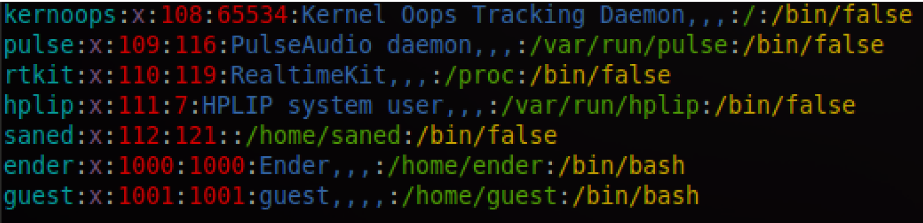
Unix Password File
User or account name
x: Hash of password (moved)
User identifier(UID)
Group identifier (GID)
Real name
Home directory
Login shell

Slide 4
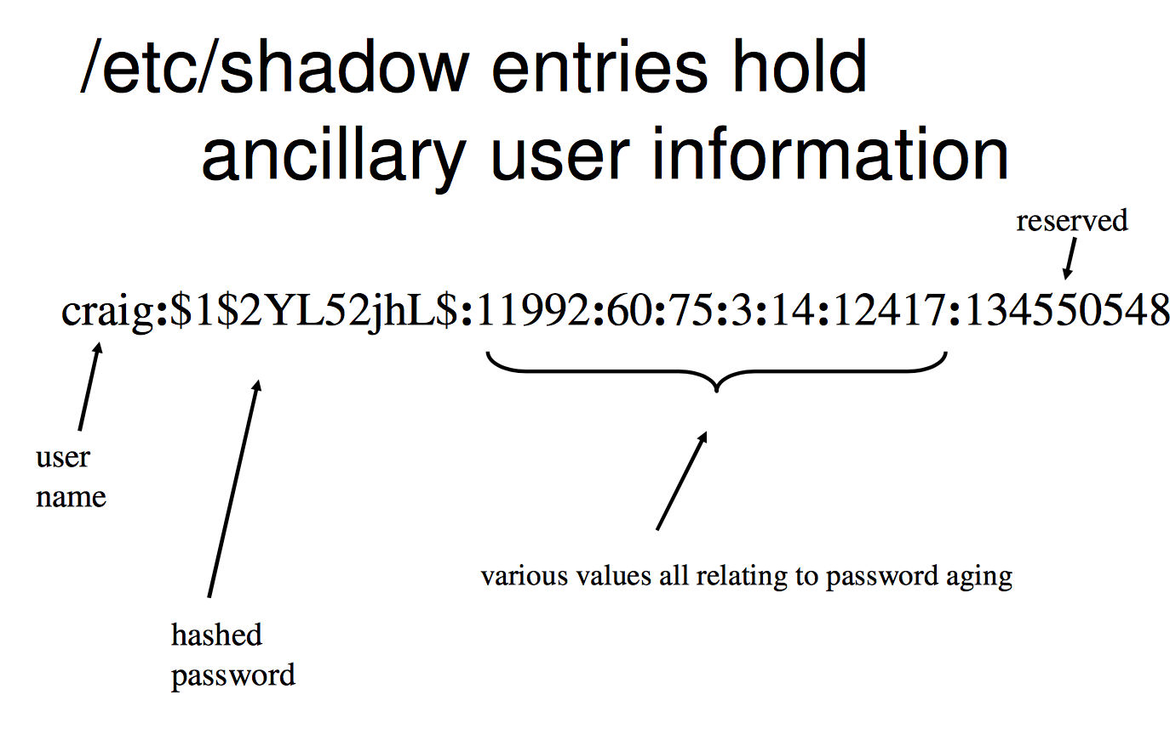
Unix Password File
Superuser can read

Slide 5
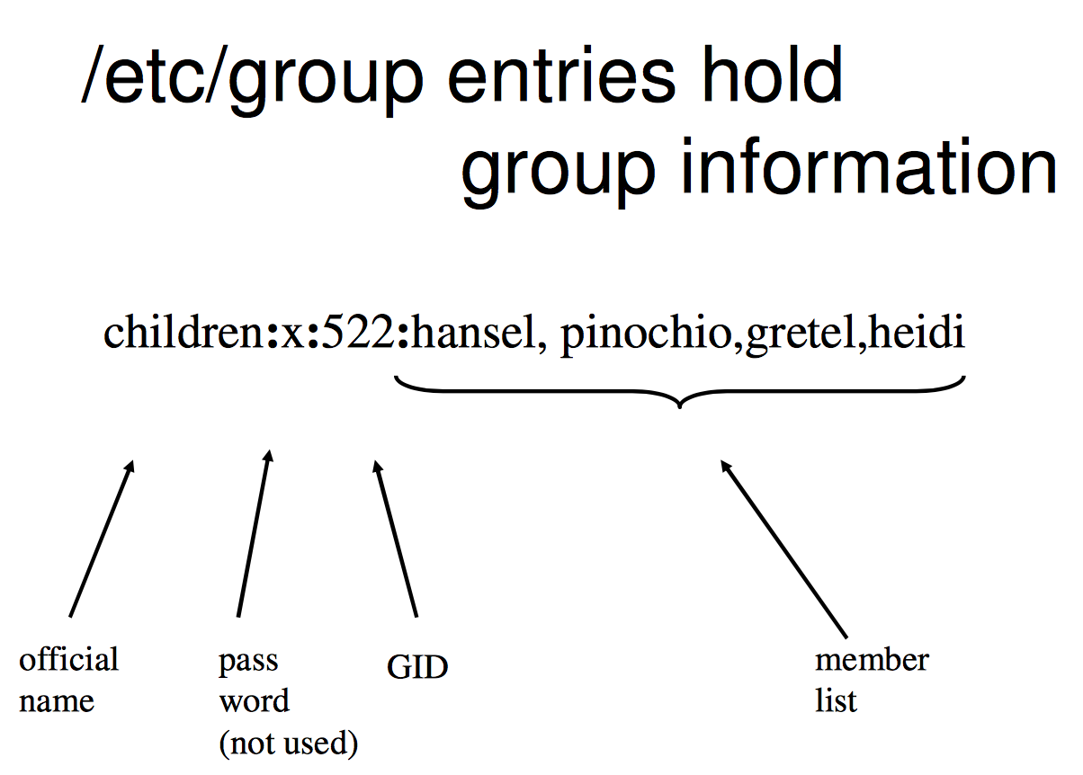

Slide 6
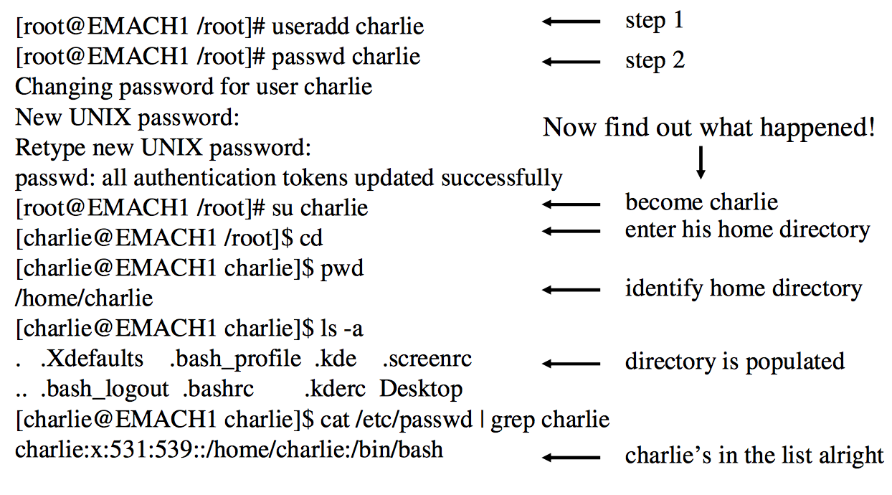
Add User

Slide 7
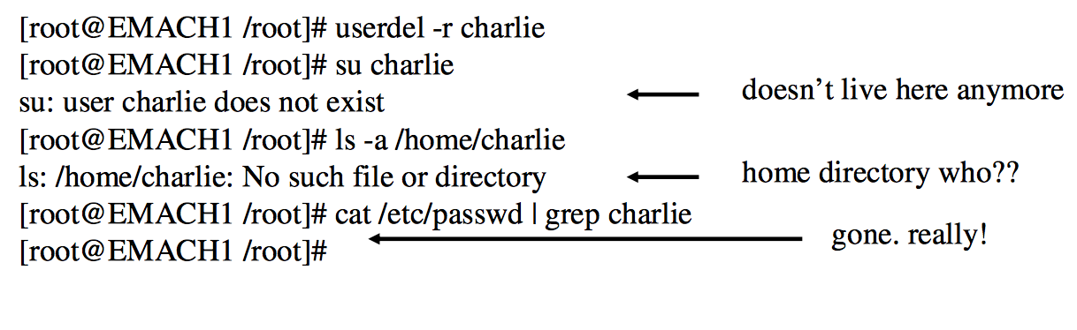
Delete User

Slide 8
Windows Password File
The Security Account Manager (SAM) file is similar to the Unix passwd File
User or account name
User number
Encrypted password
Hash 1 of password
Hash 2 of password
Full name of user
Home directory
C:\windows\system32\config\sam

Slide 9
Everyone can read the Unix passwd file
The Windows SAM file is not readable once the operating system has booted
The operating system has an exclusive lock on the Windows SAM file

Slide 10
Default Passwords
Many applications come with a default password.
VMS used to have a default super-user password.
Often, the default password is the same as the default user name.
In principle, the sys-ad changes the default password.
Recently, applications are no longer shipped with default passwords.

Slide 11
Bios Password
Stored in CMOS
Remove power from CMOS and CMOS is reset.
Looses valuable forensic data such as the system clock.
Some BIOS can be programmatically cleaned.
Looses valuable forensic data such as the system clock.

Slide 12
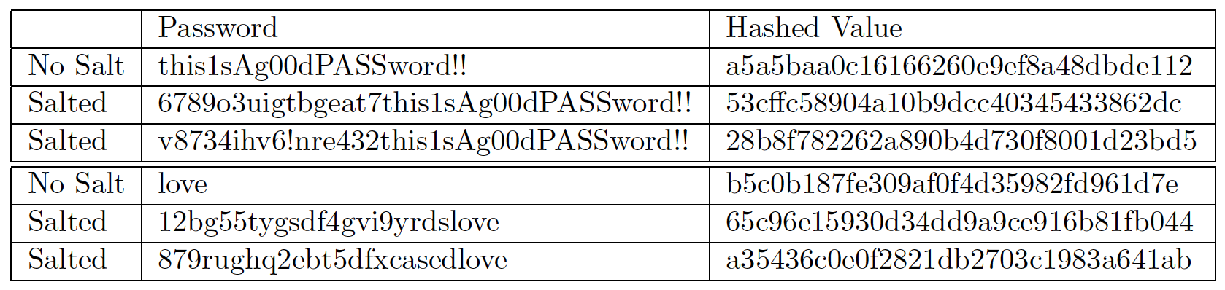
Password Salt
the md5 hash values for unsalted and salted passwords.

Slide 13
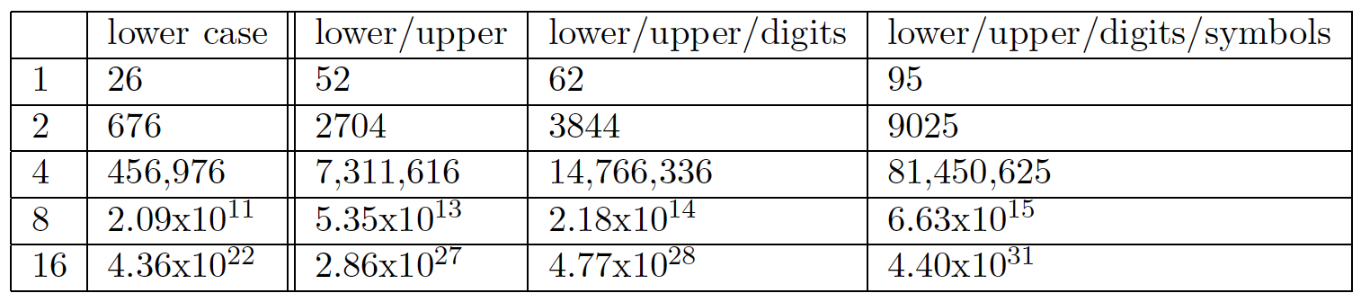
Brute Force Attack
Just try out all combinations.
It depends on the domain of input characters and the length of the password

Slide 14
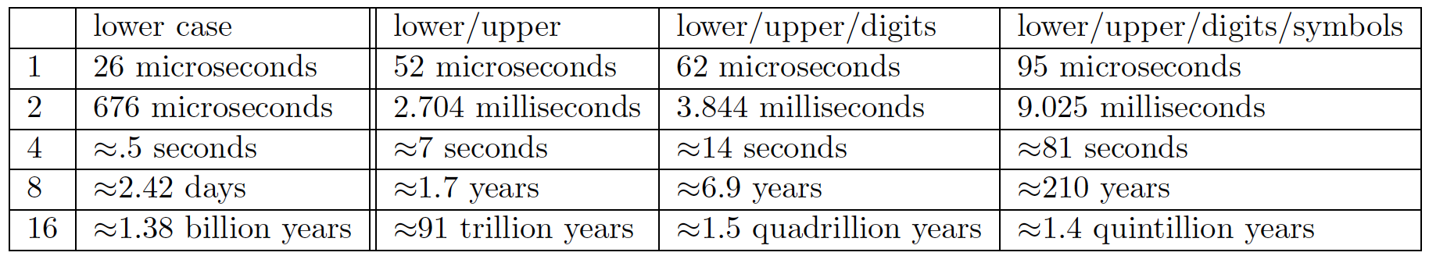
Brute Force Attack
A desktop computer could attempt one million passwords per second

Slide 15
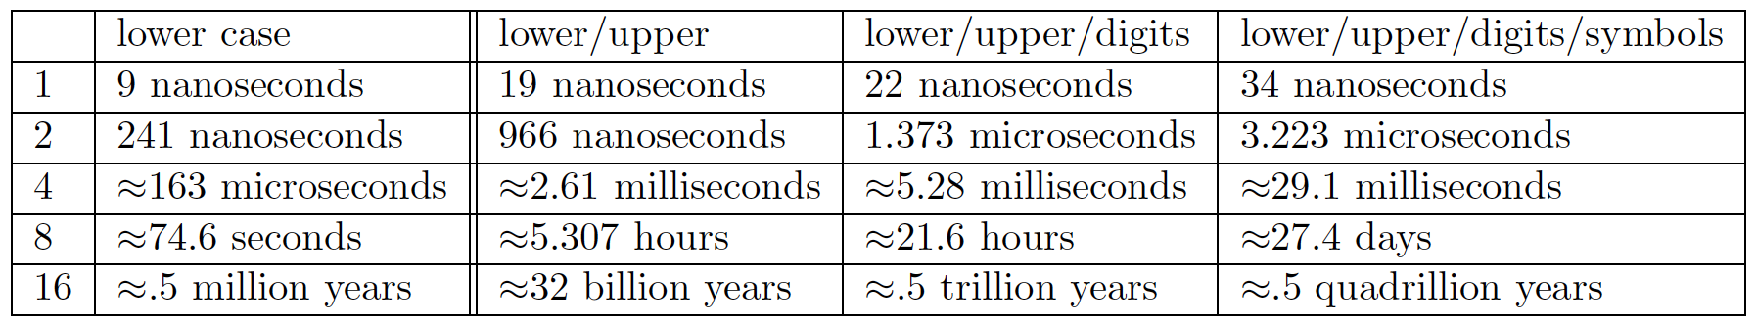
Brute Force Attack
ElcomSoft Co. claims the ability to test 2.8 billion passwords per second

Slide 16
Dictionary Attack
Passwords need to be memorizable.
Most Passwords based on actual words.
Dictionary attacks uses a dictionary:
Try all words in dictionary.
Try all words in dictionary with slight changes.
Typically very fast.

Slide 17
Keystroke logging / sniffing
Surveillance of suspect can yield passwords.
Keystroke loggers can be set up to automatically reveal typed in passwords.
Same for network sniffers.

Slide 18
John the Ripper
Combine password file and shadow file together
Unshadow PASSWORD File Shadow file > File
Crack password
John –wordlist= [] file-to-crack

